Slide 1
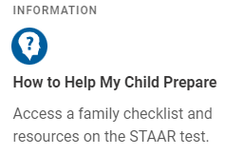
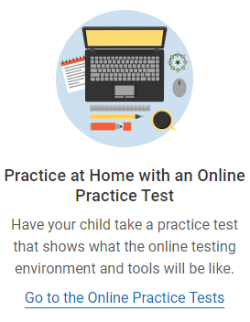
6th Grade STAAR Online Practice Test
Go to www.texasassessment.gov
Click on “Students and Families”
Click on “How to Help my Child Prepare”
Click on “Practice at Home with an Online Practice Test”
Click on “Sign In” – Do not adjust anything
Select “6th Grade”
2021 NEW STAAR Test Items
STAAR Released and Practice Tests
STAAR Released and Practice Test

Slide 2
7th Grade STAAR Online Practice Test
Go to www.texasassessment.gov
Click on “Students and Families”
Click on “How to Help my Child Prepare”
Click on “Practice at Home with an Online Practice Test”
Click on “Sign In” – Do not adjust anything
Select “7th Grade”
2021 NEW STAAR Test Items
STAAR Released and Practice Tests

Slide 3
8th Grade STAAR Online Practice Test
Go to www.texasassessment.gov
Click on “Students and Families”
Click on “How to Help my Child Prepare”
Click on “Practice at Home win an Online Practice Test”
Click on “Sign In” – Do not adjust anything
Select “8th Grade”
2021 NEW STAAR Test Items
STAAR Released and Practice Tests

